Slide 1

Real-Time Insights: Building a Medallion Architecture for Formula 1 Telemetry with Azure Data Explorer
Callon Campbell Microsoft MVP | Azure
@flying_maverick

Slide 2


About me
Callon Campbell
Azure Architect | Developer
Adastra
Microsoft MVP | Azure (2018-2024)
25 years enterprise development with Microsoft technologies – .NET (C#), Azure, ASP.NET, Desktop, SQL, and Mobile
Passionate about serverless and cloud-native application development, with focus on app migration and modernization, app integration and data analytics
Blogging at https://TheFlyingMaverick.com, and on @flying_maverick
Speaker at community events and meetups
Organizer of “Canada’s Technology Triangle .NET User Group” in Kitchener, Ontario

Slide 3
Agenda
Formula 1 telemetry data
What is a Medallion Architecture
Visualize high-velocity data streams in Azure Data Explorer
Demo (race time)
Q&A
Notes:
I’m excited to welcome you to today’s session on constructing a real-time medallion architecture tailored for Formula 1 telemetry data. We will explore how we can use Azure Data Explorer to ingest, process, and visualize high-velocity data streams. We’ll dive into the fascinating world of Formula 1, understand the Medallion Architecture, and see a live demo of how these technologies come together to provide real-time insights and enhance decision-making in dynamic environments

Slide 4
Formula 1
Highly data-driven: Extremely competitive, where a tenth of a second makes a difference.
Advanced tools: Analytics and machine learning to analyze thousands of data points per second, to find that advantage.
Telemetry data: Each F1 car has 300 sensors, generating 1.1 million data points per second, transmitted to the pits.
Data volume: With 20 cars on the circuit, approximately 160 terabytes of data is generated every race weekend.

Slide 5
Formula 1 – Key uses of telemetry data
Visualize the feedback: Helps race engineers understand drivers' feedback graphically.
Compare performance: Allows drivers to compare their own performance and against drivers.
Reliability check: Enables teams to monitor car conditions and make informed decisions, such as inspecting brake ducts for debris or advising drivers to shut down the engine if water pressure drops.
Notes:
Visualize the feedback: It provides the race engineers a graphical representation of what drivers are talking about in their feedback. e.g., a driver might complain about understeering or oversteering, which might be related to the tyre wear observed by the race engineer.
Compare performance: It allows drivers to compare their performances against each other to understand what they are doing better or worse than their peers.
Reliability check: It helps teams monitor the car, check it is running smoothly, and take the most appropriate decisions based on the data collected. For example, if the team notices brake discs overheating, they can inspect the ducts at the next pit stop to check whether a piece of debris is stuck in it. If there is a sudden drop in water pressure, the engineers will tell the driver to shut down the engine to avoid damaging it beyond repairs.

Slide 6
What is the Medallion Architecture?
A medallion architecture is a data design pattern used to logically organize data.
The goal is to incrementally improve the structure and quality of data as it flows through each layer of the architecture.
Medallion architectures are sometimes also referred to as "multi-hop" architectures.
Unstructured and raw data are ingested using scalable pipelines to output the highest quality enriched data.
Notes:
A medallion architecture, a term coined by Databricks, is a data design pattern used to logically organize data. It's the recommended design approach for Fabric Lakehouse.

Slide 7
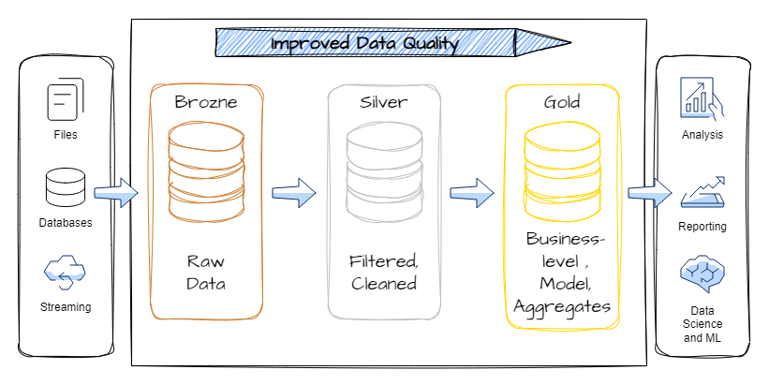
Medallion Architecture
Notes:
Medallion architecture consists of three distinct layers (or zones):
Bronze: Also known as the raw zone, this first layer stores source data in its original format. The data in this layer is typically append-only and immutable.
Silver: Also known as the enriched zone, this layer stores data sourced from the bronze layer. The raw data has been cleansed and standardized, and it's now structured as tables (rows and columns). It might also be integrated with other data to provide an enterprise view of all business entities, like customer, product, and others.
Gold: Also known as the curated zone, this final layer stores data sourced from the silver layer. The data is refined to meet specific downstream business and analytics requirements. Tables typically conform to star schema design, which supports the development of data models that are optimized for performance and usability.
Image from Exploring the Medallion Architecture in Microsoft Fabric | by Mariusz Kujawski | Medium

Slide 8
Layers of Medallion Architecture
Bronze layer:
Contains raw data, sometimes referenced as the data staging area.
May contain PII (personal identifiable information).
Consumers: Engineers
Silver layer:
Contains deduplicated, enriched data.
Contains “anonymized data” (no PII).
Consumers: Data analysts, Data scientists, Engineers.
Gold layer:
Contains aggregated data.
Built for dashboards and BI.
Consumers: End users, Business stakeholders, Data analysts, Data scientists, Engineers.
Notes:
Raw Data Ingestion: This is where raw data from various sources is ingested and stored in its original format.

Slide 9
What is Real-Time Analytics?
Get insights as soon as the data is ingested for making better decisions quickly.
Handle large amounts of data
High velocity
Low response times
Notes:
Real-time analytics platforms like Azure Data Explorer and Fabric Real-Time Intelligence provide insights as soon as the data is ingested for making better decisions quickly. They handle large amounts of data with high velocity and low response times.

Slide 10
Azure Data Explorer (ADX)
Any append-only stream of records
High volume
High velocity
High variance (structured, semi-structured, free-text)
Relational query model:
Filter, aggregate, join, calculated columns, …
Fully-managed
PaaS, Vanilla, Database
A big data analytics cloud platform optimized for interactive, ad-hoc queries
Purposely built
Rapid iterations to explore the data
Notes:
Big Data – Data that has High Volume, Velocity, variety – Structured, Semi-Structured, free text data. Append only DB.
Analytics – Can have relational query model with tables, columns, joins, filters and aggregates.
Cloud Platform – Platform as as Service where we don’t have to take care of infrastructure. With little configuration of Scale we can provision cluster, DB and start working with it. We can take care of scaling using autoscale or you can use manual scale.
Optimized – any data that is timestamped can fit right into ADX. It is optimized for timeseries data. All columns are compressed and indexed.
Interactive , ad hoc queries – ADX has native Kusto Query Language for gaining data insights. Has some similarity to SQL in terms of operators/joins etc Use KQL to – finding patterns, trends, forecasting, anomalies etc. Create near realtime dashboards

Slide 11

Batching vs streaming ingestion
Batching
Optimized for high ingestion throughput
Preferred method and most performant
Data is batched according to properties
Set ingestion batching policy on databases or tables
Default max batching value is 5 minutes, 1000 items or total of 1 GB
4 GB data size limit for a batch ingestion command
Streaming
Ongoing data ingestion from a streaming source
Near real-time latency for small sets of data per table
Initially ingested to row store
Then moved to column store extents
Steaming can be done using ADX client library or supported pipelines
NOTE: The recommendation is to ingest files between 100 MB and 1 GB.
Notes:
Data Explorer supports two types of ingestion: Batching and Streaming.
https://docs.microsoft.com/en-us/azure/data-explorer/ingest-data-overview#batching-vs-streaming-ingestion
Small batches ingested get merged and optimized behind the scenes.

Slide 12
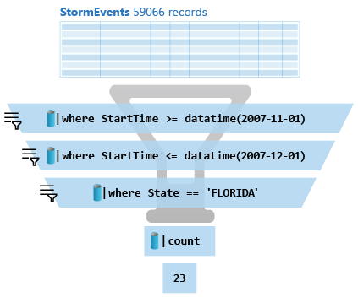
Kusto
A Kusto query is a read-only request to process data and return results.
Has one or more query statements and returns data in a tabular or graph format.
Statements are sequenced by a pipe (|). Data flows, or is piped, from one operator to the next.
The data is filtered/manipulated at each step and then fed into the following step. It's like a funnel, where you start out with an entire data table.
Each time the data passes through another operator, it's filtered, rearranged, or summarized.
Notes:
Kusto or KQL is the language used to query read-only requests
Very fast
Ideal for time-series data
Built-in Functions

Slide 13
Formula 1 telemetry with Azure Data Explorer

Slide 14
Formula 1 Telemetry Analysis Architecture
Forza Motorsport – data out telemetry via UDP.
Edge compute – .NET app to receive/send telemetry.
Azure Event Hubs to receive data.
Azure Data Explorer – ingest, transform, analyze data
Visualization – ADX, Power BI / Fabric, other.
Notes:
Accessing the telemetry data. While I do not have access to an actual Formula 1 car, we can use gaming devices like the Xbox, PC, or PS which can emit the car’s telemetry data points (speed, lap position, tyre temp/wear/damage, etc) in near real-time during the live gameplay. As you can see for my demo, I’m using Forza Motorsport (Xbox/PC).
Parsing the telemetry data. I have a .NET app which receives and parses the UDP data stream and then passes this onto Event Hubs. This application is running on the same network as my gaming device.
Ingesting telemetry data. ADX ingests data from Event Hubs connector and stores for analysis.
Visualizing the results in near real-time with real-time dashboard.

Slide 15
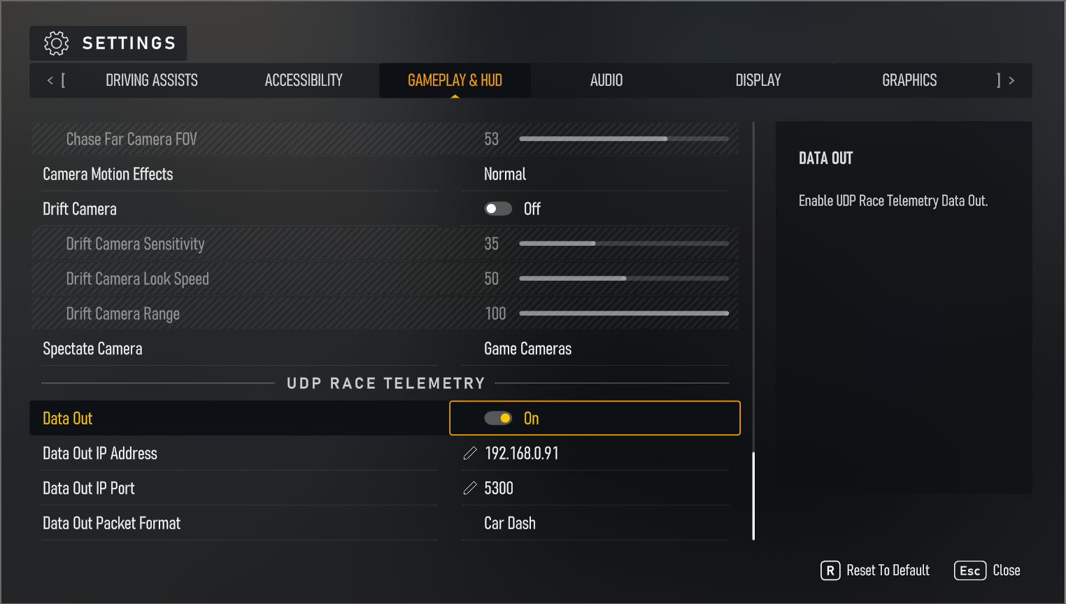
Configure Telemetry
Notes:
Need to go into settings and enable Data Out and then set the IP, Port and Packet Format.

Slide 16
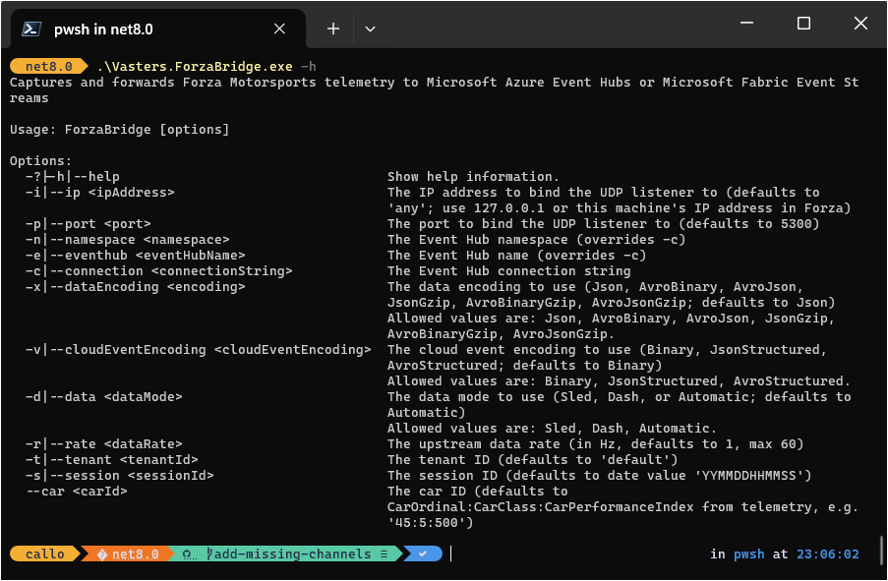
Edge Compute
.NET 8 console app (forza-telemetry-bridge)
clemensv/forza-telemetry-bridge: Bridge from Forza Motorsports to Azure Event Hubs and Fabric Event Streams
Streams 71 channel events
.\Vasters.ForzaBridge.exe -c "Endpoint=sb://demo-cac-eventhub-evhns.servicebus.windows.net/;SharedAccessKeyName=ForzaBridge;SharedAccessKey=∗∗∗∗∗∗∗∗∗∗∗∗∗∗∗∗∗∗∗∗∗∗∗∗∗∗∗∗∗∗∗∗∗∗∗∗∗∗∗∗∗∗=;EntityPath=statistics-like-evh" -i 192.168.0.91 -d Dash -r 1
Notes:
-c: Connection string
-i: IP address
-d: The data mode to use (sled, dash, automatic)
-r: The upstream data rate (in Hz, defaults to 1, max 60)
Features
Customizable telemetry data capture over UDP.
Support for various data encodings (JSON, Avro) and compressions.
Direct integration with Azure Event Hubs.
Configurable data forwarding rates and session handling.
Real-time telemetry data processing and forwarding.

Slide 17
Medallion Architecture
Notes:
Our data source is UDP telemetry from our car, parsed and send to Event Hub for streaming ingestion.
ADX is connected to Event Hubs and ingests the raw data being streamed in and maps the incoming JSON payload to the Bronze table.
Our Silver table is a curated enriched layer of data, based on transformed data from the Bronze layer that is achieved with update policy on the target Bronze table.
- To avoid expensive joins during query time, we denormalize the dimension data by enriching it during ingestion to our Silver table (facts) – ie. track, location, car details.
Our Gold table is aggregated data for reporting and BI, this can be achieved with materialized views against the Silver table to yield the most current event data (deduplication).
The availability of the event data in the target tables is quasi-instantaneous after ingestion.
Our visualization layer can use a mixture of data from both Silver and Gold tables depending on what is trying to be analyzed.

Slide 18
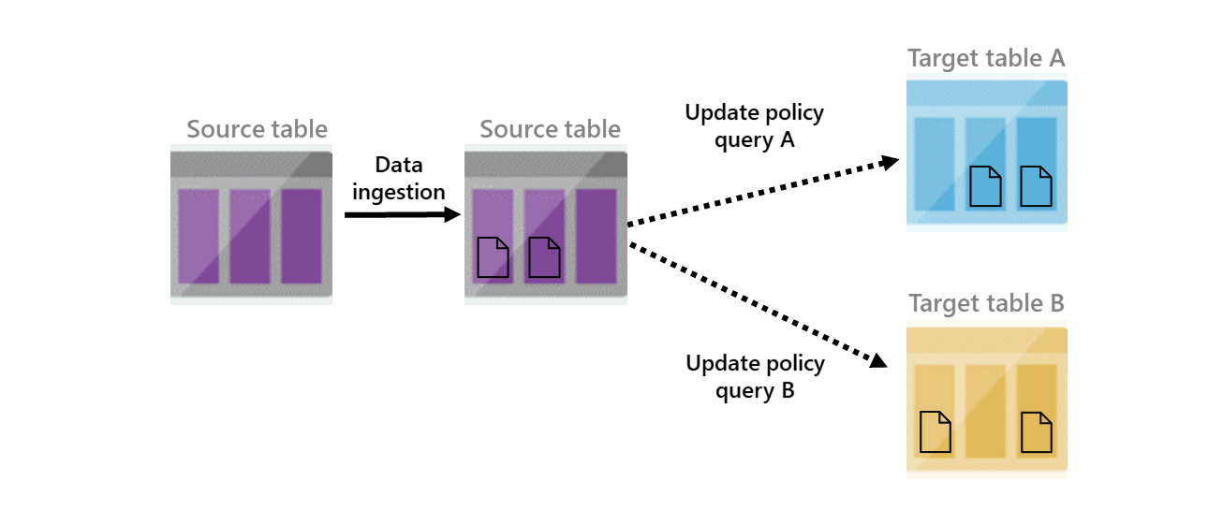
Update Policy
Inner ETL / Trigger
Works with medallion architecture
Source table is scoped to newly ingested data
Scenarios
Filter out data, deduplication
Created calculated columns, changing schema, joining static dimension data
Different retention policies for subset of the data
Notes:
Update policy is like an internal ETL. It can help you manipulate or enrich the data as it gets ingested into the source table (e.g. extracting JSON into separate columns, creating a new calculated column, joining the new records with a static dimension table that is already in your database, etc).
It provides an efficient way to apply rapid transformations and is compatible with the medallion architecture.
In the medallion architecture, when raw data lands in a landing table (bronze layer), an update policy can be used to apply initial transformations and save the enriched output to a silver layer table. This process can cascade, where the data from the silver layer table can trigger another update policy to further refine the data and hydrate a gold layer table.
This is a very efficient way of transforming the data upstream when its ingested.

Slide 19
Demo
Database setup, KQL

Slide 20
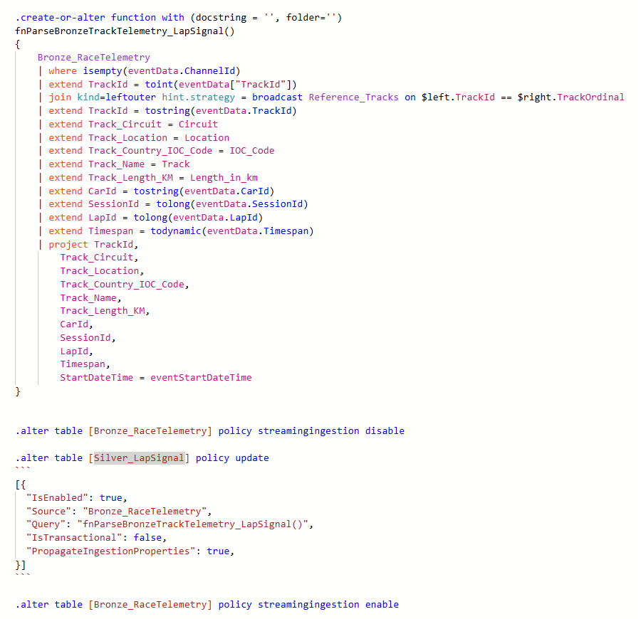
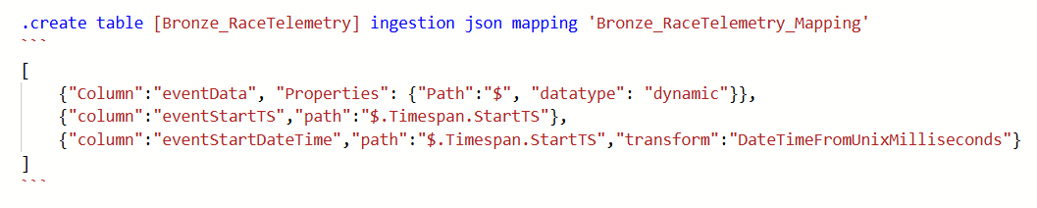
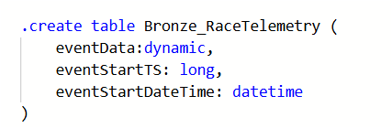
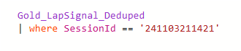
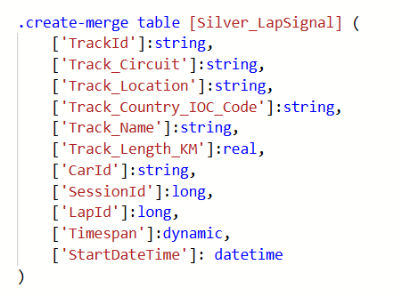
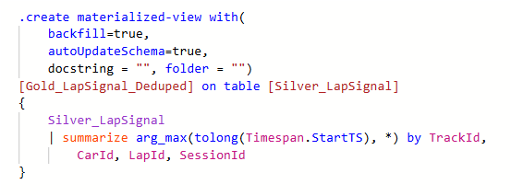
Data Flow
1
JSON
Ingest
2
3
Copy and transform
6
5
4
Query
Project / Dedup
Store

Slide 21
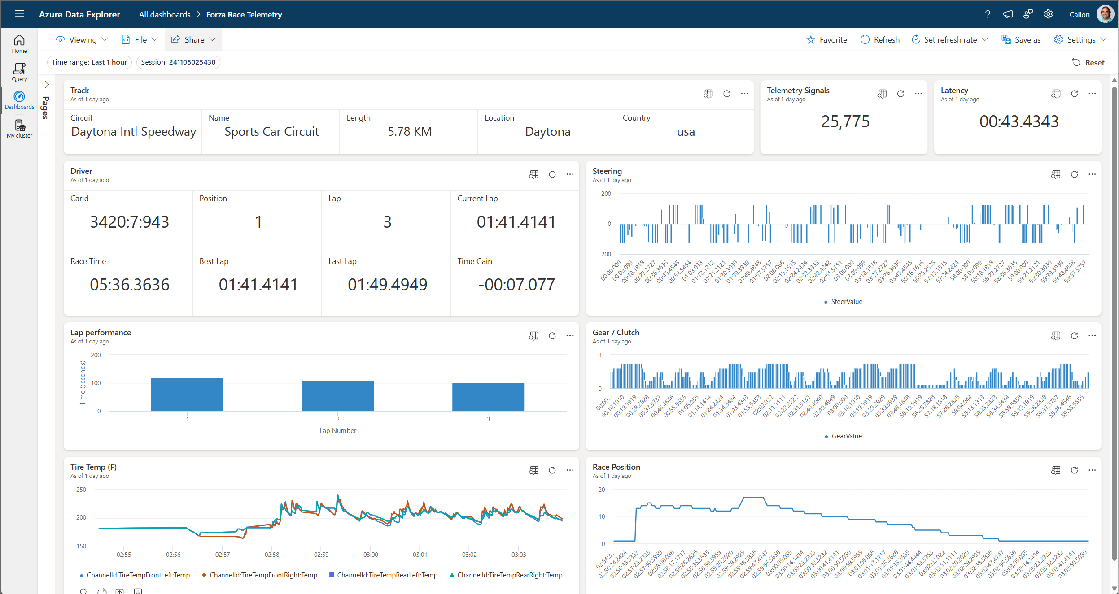
Real-Time Dashboard

Slide 22
Demo
Let’s race!

Slide 23
Wrap-up
Real-time medallion architecture for Formula 1 telemetry data using Azure Data Explorer.
How to ingest, process, and visualize high-velocity data streams.
Derive real-time insights and performance analysis.

Slide 24
Q&A
How can Azure Data Explorer can help you?
How can I build this in Microsoft Fabric Real-Time Intelligence?

Slide 25
References
Forza Motorsport
Forza Motorsport "Data Out" Documentation – Forza Support
clemensv/forza-telemetry-bridge: Bridge from Forza Motorsports to Azure Event Hubs and Fabric Event Streams
bluemanos/forza-motorsport-car-track-ordinal: Forza Motorsport cars and tracks ordinal data
Microsoft
Azure Data Explorer documentation
Implement medallion lakehouse architecture in Fabric

Slide 26




Let’s connect
Callon@CloudMavericks.ca
@Flying_Maverick
https://LinkedIn.com/in/CallonCampbell
https://GitHub.com/CallonCampbell

Slide 27
Azure Data Explorer References
https://aka.ms/adx.docs
https://aka.ms/kustofree
https://aka.ms/adx.try
https://aka.ms/adx.lab
https://aka.ms/adx.cost
https://aka.ms/adx.architectures

Slide 28
Did you know
The Azure Data Explorer (ADX), formerly known by its internal code name “Kusto”, has an interesting origin story.
Back in 2014, the team needed a name that captured the essence of their mission: exploring vast oceans of data. Inspired by the legendary oceanographer Jacques Cousteau, they chose the internal code name "Kusto". Just like Cousteau explored the depths of the ocean, the Kusto project aimed to tackle the challenges of fast and scalable log and telemetry analytics.

Slide 29
Azure Data Explorer (ADX)
Any append-only stream of records
High volume
High velocity
High variance (structured, semi-structured, free-text)
Relational query model:
Filter, aggregate, join, calculated columns, …
Fully-managed
PaaS, Vanilla, Database
A big data analytics cloud platform optimized for interactive, ad-hoc queries
Purposely built
Rapid iterations to explore the data
Notes:
Azure Data Explorer is a fully managed, high-performance, big data analytics platform that makes it easy to analyze high volumes of data in near real time. The Azure Data Explorer toolbox gives you an end-to-end solution for data ingestion, query, visualization, and management.
Big Data – Data that has High Volume, Velocity, variety – Structured, Semi-Structured, free text data. Append only DB.
Analytics – Can have relational query model with tables, columns, joins, filters and aggregates.
Cloud Platform – Platform as as Service where we don’t have to take care of infrastructure. With little configuration of Scale we can provision cluster, DB and start working with it. We can take care of scaling using autoscale or you can use manual scale.
Optimized – any data that is timestamped can fit right into ADX. It is optimized for timeseries data. All columns are compressed and indexed.
Interactive , ad hoc queries – ADX has native Kusto Query Language for gaining data insights. Has some similarity to SQL in terms of operators/joins etc Use KQL to – finding patterns, trends, forecasting, anomalies etc. Create near realtime dashboards

Slide 30

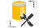
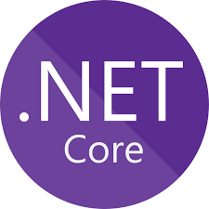


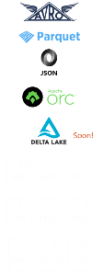
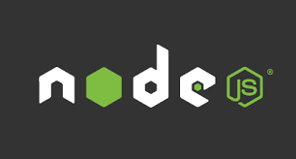









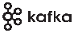









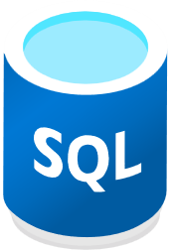
Azure Data Explorer Architecture
Data Consumption ecosystem
Data Ingestion ecosystem
Query Tools
SDKs
Data Formats
Notebook Connectivity
Managed pipelines
Visualization
Batching
ADX Dashboard
Streaming
API and Client Libraries
REST API
Connection & plugins
Orchestration
Connectors
Tools
TDS, JDBC, ODBC
One Click Ingestion
Export
LightIngest
Notes:
Azure Data Explorer Architecture Overview
Time series database
Azure PaaS cluster
Data storage benefits from compression
Ingest only, mostly querying, not data manipulation

Slide 31
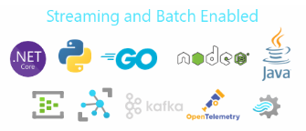

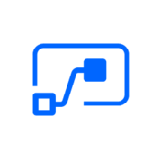
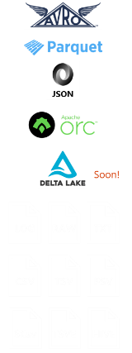




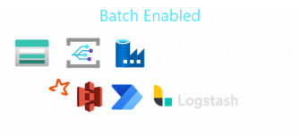
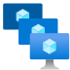




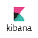

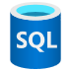





Data Explorer
Real Time Data Analytics Platform
Data Formats
Data Ingestion
Data Explorer Cluster
Data Retrieval
REST API
TDS, JDBC, ODBC
Compute
(with SSD cache)
In-place Transformation
Data Visualization
ADX Dashboard
Analytics Engine
Cross-Query Data Sources
Advanced Analytics & ML
Storage
Compressed Data
Storage
Timeseries Functions
Geospatial
Data Sharing (Follower Cluster)
Enterprise Readiness
Data Encryption, Network Security, RBAC
Multi-tenancy, Azure Active Directory Integration
Availability, Performance, Automation, Monitoring
Security
Running on Azure Platform, Available in 50+ Regions, Ring 1 Service

Slide 32





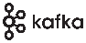


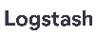

Data Management and Ingestion
1
SDKs
Managed pipelines
Data Explorer
Connections
Batching
Data Explorer
Engine
Data Management
Ingestion
Connection & plugins
Management
Tools
One Click Ingestion
LightIngest
Notes:
You can ingest data in Data Explorer in many ways.
Using our SDKs.
Use managed pipelines where Data Explorer will automatically read the data from IoT Hub, EventHub or Storage\Data Lake, Cosmos DB, etc.
Use any of the 1st party connectors and agents to push data from Kafka, Spark, Logstach, PowerApp, FluentBit, and Telegraph agents.
Use Azure Data Factory\Synapse Pipelines to bring data from wide variety of sources.
Data Explorer support automated batching of the data for efficient ingestion and can ingest up 200 MB/sec csv files per 16 cores compute.
It support wide variety of formats such as JSON, Parquet, Orc, Avro and more.

Slide 33

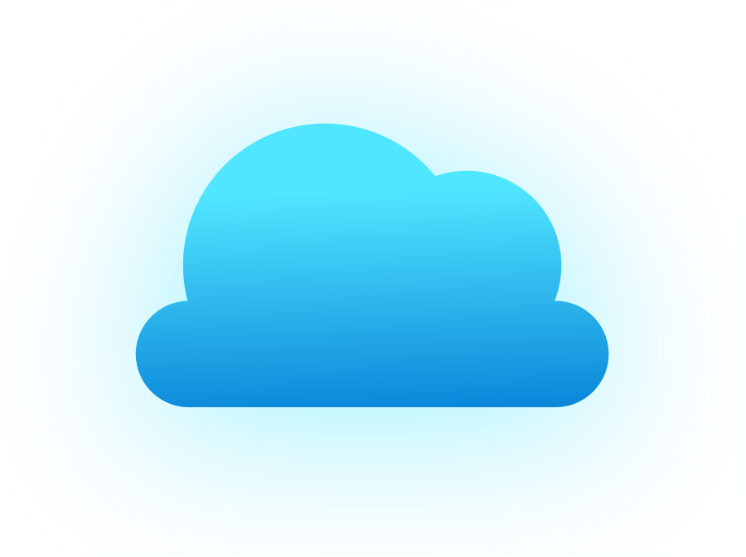
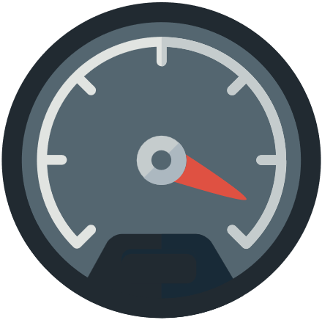

Cross Queries
1
Between Data Explorer databases and clusters
Query SQL pool from Data Explorer
Query Azure Monitor from Data Explorer
Query Cosmos DB from Data Explorer
Query Data Lake from Data Explorer
Notes:
You may have scenarios where you may want to create multiple Data Explorer clusters for storing different types of data or host different pool is different regions or different divisions in your company many have their own Data Explore clusters.
In all these scenarios cross database\cluster enable you to easily cross query between database, between ADX clusters in same region or other regions.
Data Explorer is integrated with rest of the Azure ecosystem, in cases where you don’t want to ingest the data in Data Explorer – you can query it easily from SQL, Azure Monitor, Cosmos DB, and Data Lake.

Slide 34

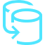
Data Sharing
1
Share data within the company
Load balancing
Data-as-a-service
Hub and Spoke model
Chargeback
Ingest
Query
Query
Leader
Follower
Follower
No Maintenance
In-Place Data Sharing
No data pipeline to maintain
Near real-time updates
Symbolic link
R/W
R/W
R/W
R
R/W
DB1
DB2
DB3
DB3
DB4
Compute
Compute
Azure Blob Storage
Azure Blob Storage
Notes:
Thanks to the separation of storage and compute in Data Explorer pool.
You can have one Data Explorer pool for ingesting and querying the data and share the databases with multiple Data Explorer pools.
This enables you to load balance, offer data-as-a-service, build Hub and Spoke model, or chargeback to you internal teams.
Its all automated and real-time caching, you don’t need to maintain any pipeline.

